Slide 1
The Pandemic
The pandemic behind
Social media response to Covid-19 breakthrough

Slide 2
Our Goals
Covid-19 and media influence
A
Social Network response - Reddit
1
Journalism response
2
Finding relations between day by day Covid-19 evolution and information flow
Targeted analysis on how Covid-19 discussion evolved in a social network: Reddit
Regional analysis on how Covid-19 discussion evolved in journalism

Slide 3
Work progress
DATA COLLECTION
DATA ANALYSIS
CONCLUSIONS
We collected data from Reddit, various news outlets and LaProtecioneCivile
We developed for polarity detection models, topic models and predictive models
We tried to gain insight on how people generally reacted to the breakthrough

Slide 4
Our group
Negin Amininodoushan
Marco Muscas
Leonardo Placidi
Stefano Rando
Davide Zingaro

Slide 5
Let’s get started!
Enjoy your ride!

Slide 6
Reddit Section 1:
Sentiment Analysis on Reddit
Detecting polarity of comments on Reddit

Slide 7



Contents
SENTIMENT ANALYSIS
MODELS
APPLICATION
Classifying documents as either positive, negative or neutral
Naive Bayes, SVMs and BERT pre-trained models
Classifying Reddit italian comments concerning Covid-19

Slide 8
Sentiment Analysis
01.
Classifying documents on the basis of polarity

Slide 9
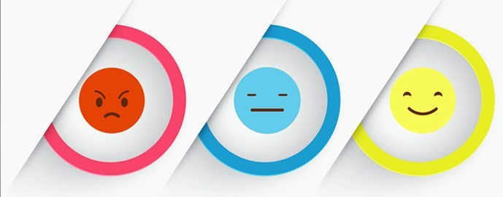
What is Sentiment Analysis?
In sentiment analysis, or opinion mining, (SAOM), the goal is to discover people’s opinions expressed in written language (text). Sentiment in term means “what one feels about something”, “personal experience, one’s own feeling”, “an attitude toward something” or “an opinion”[4].

Slide 10
Models
02.
A brief journey in SVM and Bayes classifiers.

Slide 11




Recap of SVM
SVM
TASK
Support Vector Machine
Build an hyperplane or set of hyperplanes in high-dim space
GOAL
REDUCTION
Predict the sentiment of comments (classification)
Dimensionality reduction methods

Slide 12
Bayes Classifiers
We tried many methods based on Bayes theory, more on this later!
Gaussian
Bernoulli
Multinomial

Slide 13
BERT
A.
B.
C.
D.
NEURAL NETWORK
PRE-TRAINED
Multilayers and flexible
The first layers are trained on huge data!
RE-TRAINED
ATTENTION LAYERS
Train set with already classified texts
Layers to avoid RNNs (usually too slow)

Slide 14
Application
03.
Scoring methods and model selection

Slide 15
Our Train Data comes from 3 sources:
01
02
03
Reddit comments classified BY HAND BY US
~#600
Amazon reviews that we scraped and classified
~#500
Wikipedia articles as example of neutrality
~#140
Validation set ~200.

Slide 16
OUR MONSTER TEST SET!
#154656 of comments

Slide 17



AND THE BERT METHOD IS…. BEST
ACCURACY SCORING
SVM
NAIVE BAYES
BERT
67%
36-58%
80%

Slide 18

Project data
Reddit italian comments on Covid-19 specific threads

Slide 19
Data structure
FEBRUARY
Wednesday
26
“Eccetto grandi carenze di amuchina non mi pare tutto sto casino, la gente esce, lavora normalmente.”
MARCH
Saturday
14
“Domani si festeggia ufficialmente il funerale di tutte le partite Iva d’Italia.”
APRIL
TUESDAY
21
“Dite quello che volete, ma il silenzio della sera è una cosa bellissima e mi mancherà.”

Slide 20
Reddit Section 2:
Topic modeling of Reddit comments
Latent Dirichlet Allocation and evaluation methods

Slide 21



Contents
TOPIC MODELING
LDA
EVALUATION
What is a Topic model and problem formalization
Method presentation: Latent Dirichlet Allocation
How to measure efficiency of a Topic model

Slide 22
Topic Modeling
01.
How to classify documents in an unsupervised setting

Slide 23
—[1]
The main importance of topic modeling is to discover patterns of word-use and how to connect documents that share similar patterns.

Slide 24
Main aspects of Topic Modeling
A.
B.
C.
D.
Unsupervised setting
Text mining
The model has to find patterns by itself
Use of text processing techniques
Clustering
Generative approach
Associations of documents to topics
Leverage on Bayesian models

Slide 25
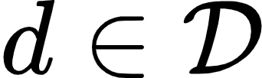

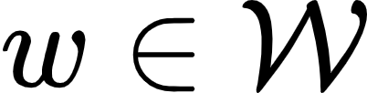
Formalization and assumptions
01
02
03
At every step a topic
A document
A word
Is selected
Is chosen
Is picked

Slide 26

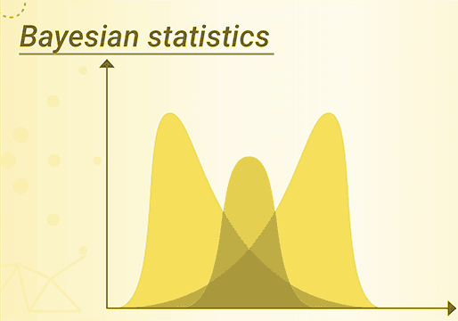
Our Problem - Find

Slide 27
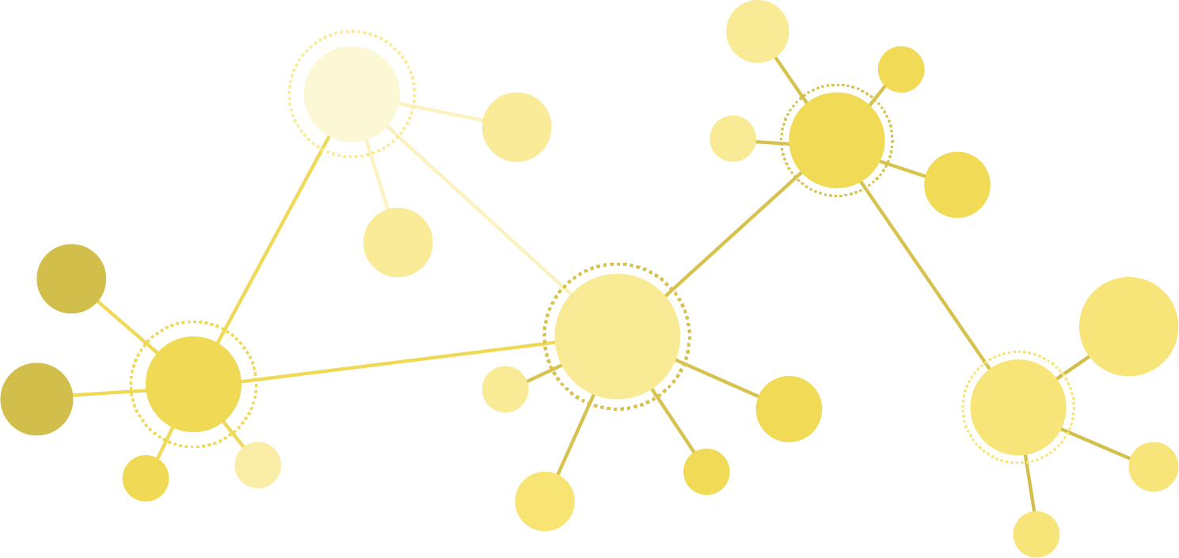
Research
Trying to identify around which topics Covid-19 discussions revolved in social networks like Reddit.

Slide 28
Latent Dirichlet Allocation
02.
A Bayesian hierarchical model for topic modeling

Slide 29




Recap of Bayesian statistics
MODEL
PRIOR PROBABILITY
A model, depending on some parameters, is assumed
Parameters of the model are treated as random themselves
HIERARCHICAL
POSTERIOR PROBABILITY
More models can sequentially depend from one another
Distribution of parameters is updated based on data

Slide 30




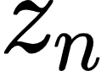

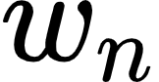

Latent Dirichlet Allocation
 | DISTRIBUTION | PARAMETER | KNOWING
Choose number of words | Poisson |  | -
Choose topics distribution | Dirichlet |  | -
Then for every word...
Choose a topic | Multinomial |  | -
Choose a word | Multinomial

Slide 31
Steps
TEXT EMBEDDING Vectors of terms occurrences
EVALUATION More on this later...
01
02
03
04
TEXT PROCESSING Cleaning, tokenization, stemming
PARAMETERS CHOOSING
Number of topics, prior probabilities

Slide 32
Application on Reddit comments
LDA applied to project dataset identified three trends

Slide 33



Categories found with LDA
COMMENTS
COVID LIFE IMPACT
DISCUSSION ON CASES
ENGLISH COMMENTS
“La mia azienda (Milano) chiude lunedì per precauzione. A me più della malattia fa paura la quarantena coatta.”
“Non lo sappiamo, ma siamo passati da averne +1380 positivi in un giorno ad averne +322 il giorno seguente.”
“I’m going to Tuscany in a few days, has anything been mentioned about that area of if it will go on lockdown?”

Slide 34
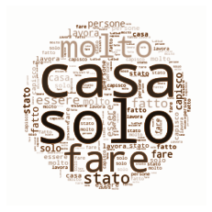

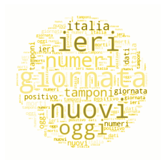
10%
22%
68%

Slide 35
Evaluation
03.
Measures of efficiency for Topic models

Slide 36

Problems
Can we trust LDA topics recognition?
How many topics should we try to detect?

Slide 37


Approaches
AUTOMATIC
HUMAN-BASED
Unsupervised evaluation. No human intervention or classification.
Supervised evaluation.
Different people subjectively evaluate effectiveness.

Slide 38
Automatic: Google titles matches [2]
01
02
03
For every topic extract the 10 most important keywords
Perform a Google search over documents containing all these terms
Count how many times keywords appear in title

Slide 39
Human-Based: Word intrusion [3]
TOTALE |  | Related - No votes
MORTI |  | Related - No votes
GIORNATA |  | Related - 4 votes
REGIONE |  | Related - 2 votes
CORONAVIRUS |  | Related - 1 vote
DEFIBRILLATORE |  | Unrelated - 4 votes

Slide 40
Evaluation of the comments model
Number of topics selection and effectiveness evaluation

Slide 41
TITLES for choosing number of topics and model
2
3
4
5
6
7
LDA
77.5
77.3
25.3
0
Median
77.5
99
14
0
R-LDA
77.5
77.3
25.3
0
Median
77.5
99
14
0

Slide 42
Word intrusion for assessing effectiveness
60%
83%
11
Average rate of correct answers
Questions which obtained most votes for correct answers
Participants

Slide 43
Reddit Section 3:
Time analysis of Reddit comments trends
Evolution of topic and sentiment trends on comments over time

Slide 44
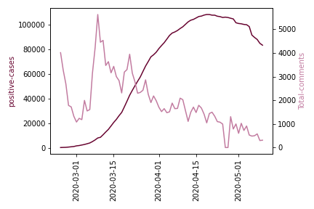
Reddit comments and total positive

Slide 45
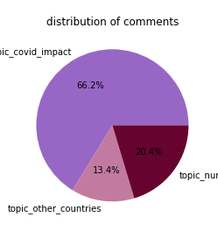
Topic modeling results
Covid impact on life
English comments
Discussion on cases and numbers
Topics distribution
66.2%
20.2%
13.2%

Slide 46
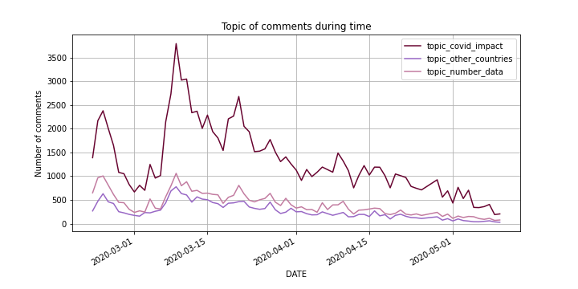
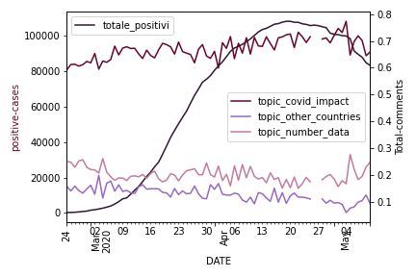
Topic distribution over time

Slide 47
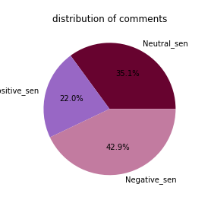
Sentiment analysis results
Positive comments
Negative comments
Neutral comments
Polarity distribution
35.1%
22.0%
42.9%

Slide 48
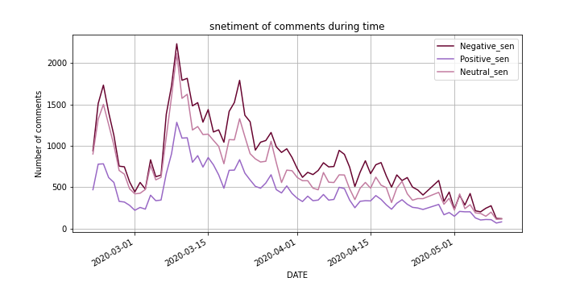
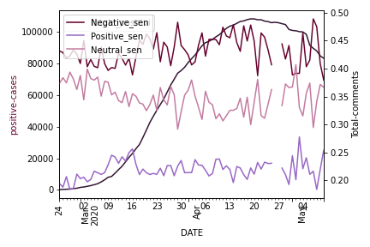
Sentiments over time

Slide 49
References
[1] - Alghamdi, Alfaqi “A Survey of Topic Modeling in Text Mining” International Journal of Advanced Computer Science and Application 2015
[2] - Newman, Han Lau, Grieser, Baldwin “Automatic Evaluation of Topic Coherence” Association for Computer Linguistics 2009
[3] - Wang “Topic Modeling: A Complete Introductory Guide” ResearchGate 2017
[4] - Fundamentals of Sentiment Analysis and Its Applications
Mohsen Farhadloo and Erik Rolland, ResearchGate 2016

Slide 50
Topic Modeling for articles & predictive model

Slide 51
Contents:
Data collection:
Download of html pages
Creating the parsers for each news outlet website
Filling of missing data
Preprocessing of data:
Stemming, Removal of special characters from text
Removal of stop-words
Classification:
Arbitrary keywords classifier
Latent Dirichlet Allocation
Non-negative matrix factorization
Plotting of classified data
Adding new features to the data
Creation of predictive model
Test and performance evaluation

Slide 52
Data Collection

Slide 53
Download of html pages
A first try….
Downloading from an news indexing site:
Pro:
Ease of access and download
Con:
Missing articles
Imbalance of available data
Anti crawling

Slide 54
Download of html pages
The final solution…
Target the individual news outlets websites

Slide 55
b. Creating the parsers for each news outlet website
Note: We were careful not to overload the websites with requests
We had an URL for each article:
Individual parsers for each news outlet
Parallelizing the requests and parsing for each news outlet

Slide 56
c. Filling of missing data
Each Parser created a CSV.
The CSVs were merged...
...Incomplete data was dropped
Result:
24584 articles

Slide 57
2. Preprocessing of Data

Slide 58

Stemming, Removal of special characters from text
?!#
Notizie notiz
Conversion to lower-case
Special character removal
Stemming
Both title and content
Library defined punctuation and RegEx, removal of stop-words
Snowball Stemmer method for italian language

Slide 59
3. Classification

Slide 60
We chose between 3 possible models...
01
02
03
Dummy model
LDA
NMF
Obvious keyword selection
Clustered keywords

Slide 61
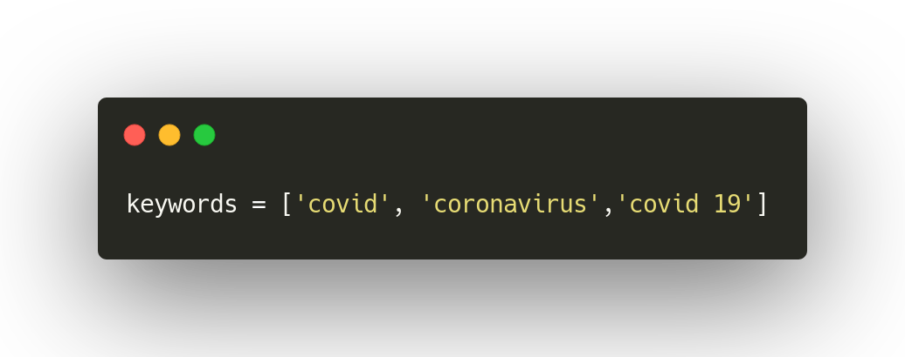
Arbitrary keywords classifier
Used as Reference Model…
Matching arbitrary keywords

Slide 62
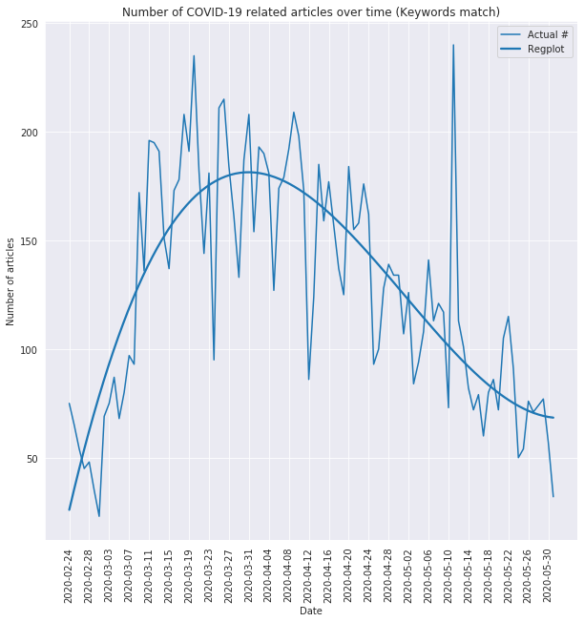
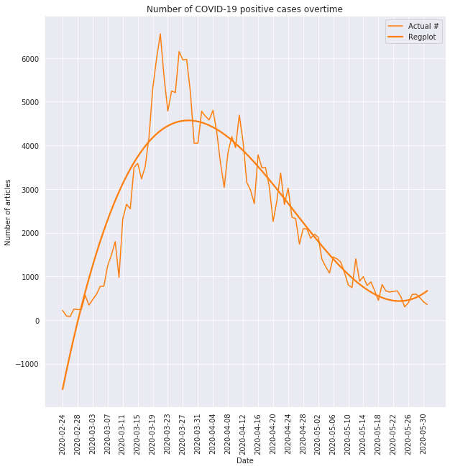
Arbitrary keywords classifier
It was not super great…
...Too many false positive as more keywords were added

Slide 63
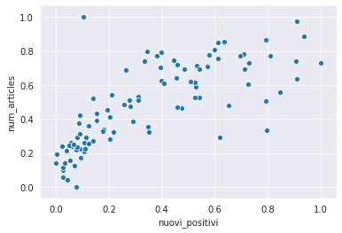
Arbitrary keywords classifier
The correlation value is 0.81, p-value: 6,99*E-24

Slide 64
b. Latent Dirichlet Allocation
We created a bag of words matrix using all content from each article
We then used the matrix to train the LDA classifier
The results were not useful...

Slide 65
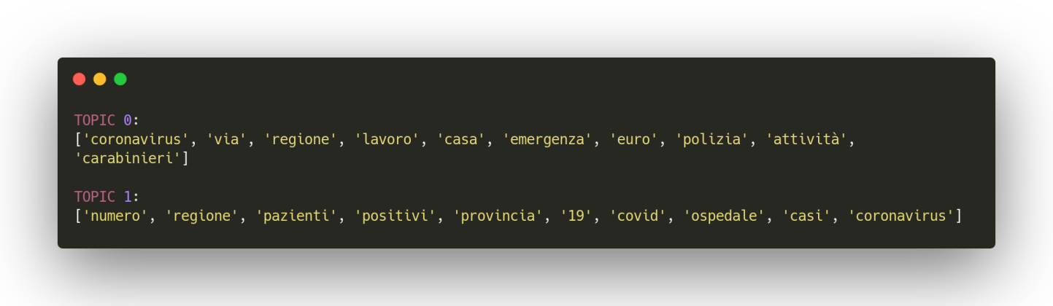
b. Latent Dirichlet Allocation
Even for two clusters...
We couldn’t use these keywords, since some appeared in both. Classification was ambiguous.

Slide 66



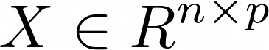
Non-negative Matrix Factorization
01
02
03
Starting Matrix
Reducing p to r
with
Approximation
Matrix of n points each with p dimensions

Slide 67
c. Non-negative matrix factorization
For Text Mining:
Consider the bag-of-words matrix representation…
Row corresponds to a word
Column to a document

Slide 68
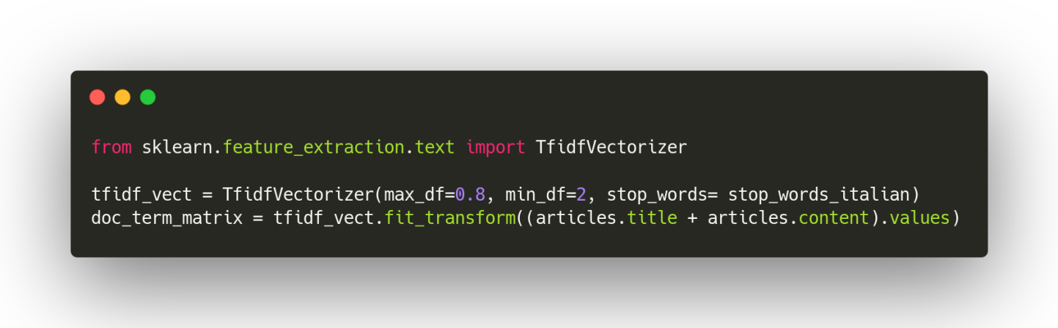
c. Non-negative matrix factorization
To perform...
Clustering
Dimensionality reduction
In combination con TF-IDF scheme on content data.

Slide 69
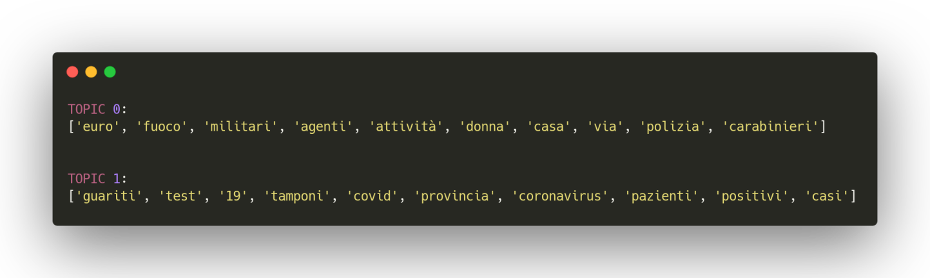
c. Non-negative matrix factorization
We got very distinct cluster
We got two clusters of keywords that were deeply different in respect to each other.

Slide 70
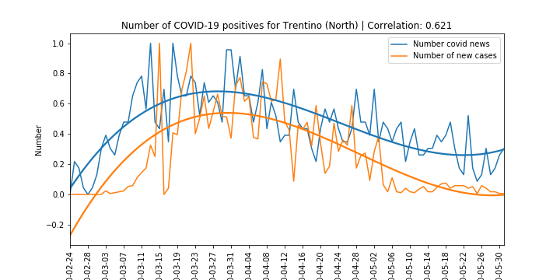
Region and Zones plots

Slide 71
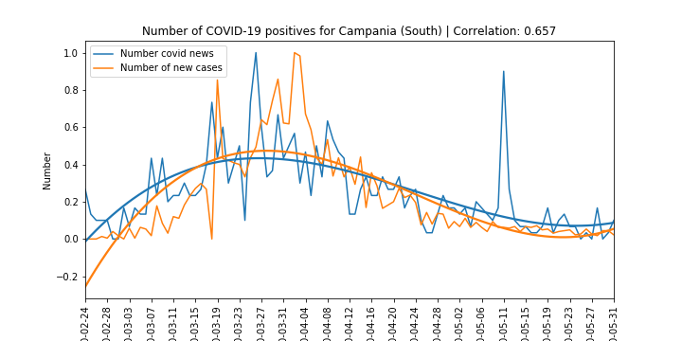
Region and Zones plots

Slide 72
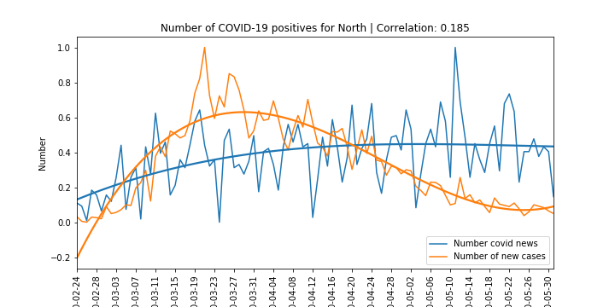
North of Italy...

Slide 73
c. Adding new features to the data, and creation of predictive model
Objective:
Predicting national data from articles
Raw text (‘title’, ‘content’ columns) by itself was not suitable^{[3]}...

Slide 74
c. Adding new features to the data, and creation of predictive model
We selected the most important terms that we obtained from the NMF model…
Using those keywords we did One hot encoding on the content of each article…
Grouping up by date, we got the total number of daily news where each term appeared.

Slide 75
c. Adding new features to the data, and creation of predictive model
We selected a Random Forest model to try to predict the ‘nuovi_positivi’ column from the Protezione Civile data…

Slide 76
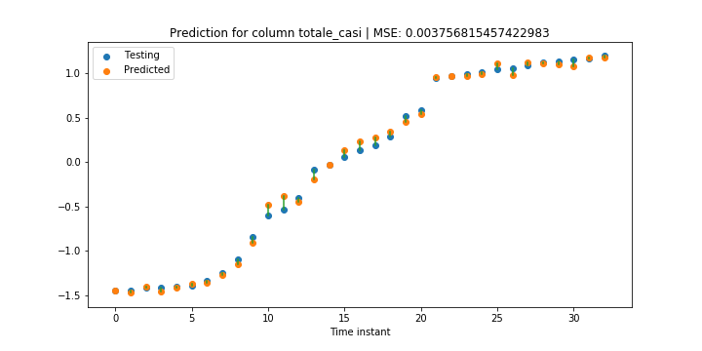
‘Totale_casi’

Slide 77
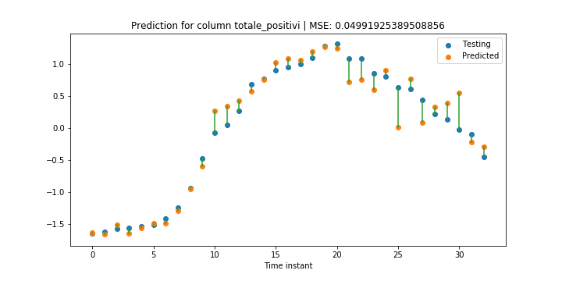
‘Totale_positivi’

Slide 78
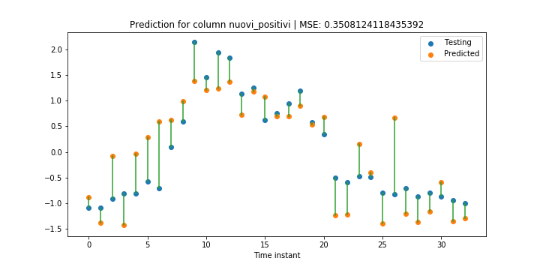
‘Nuovi_positivi’

Slide 79
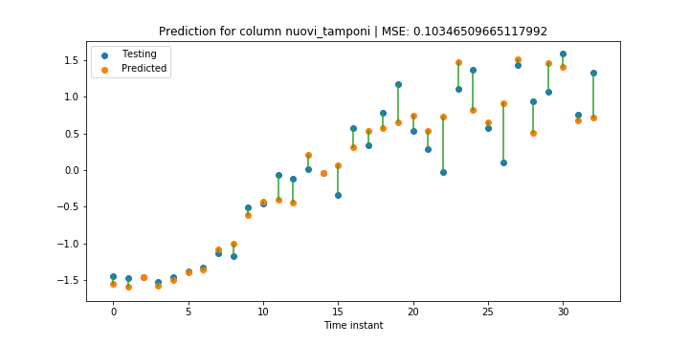
‘Nuovi_tamponi’

Slide 80
References
[1] - Berry, Gillis and Glineur “Document Classification Using Nonnegative Matrix Factorization and Underapproximation” 2009
[2] - Okun “Non-negative matrix factorization and classifiers: experimental study” 2008
[3] - Caragea, Cornelia, Jian Wu, Kyle Williams, Das, Khabsa, Teregowda and Giles. “Automatic Identification of Research Articles from Crawled Documents.” (2014).

